Slide 1
Novel Computational Approaches to Investigate Microbial Diversity
Qingpeng Zhang
Department of Computer Science and Engineering
Michigan State University
Advisor: Dr. Titus Brown

Slide 2
Outline
Background and motivation
An efficient k-mer counting approach
Novel method to investigate microbial diversity
Concept of IGS (informative genomic segment)
Testing IGS method on simulated data sets
Testing IGS method on real metagenome data
Summary
Background and motivation
Notes:
Ok let’s talk about motivation. Why we want to do this. Try so hard to investiage microbial diversity.

Slide 3
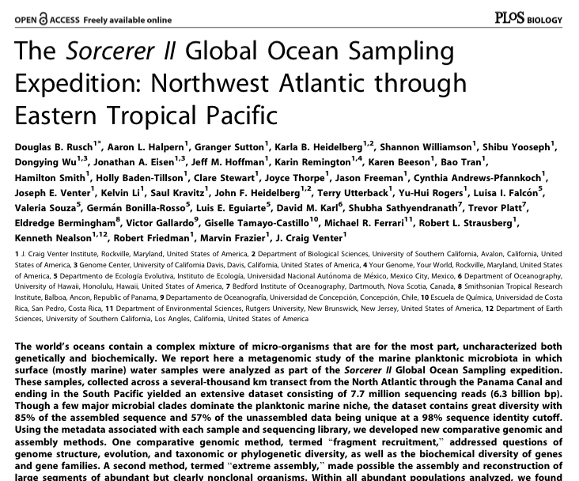
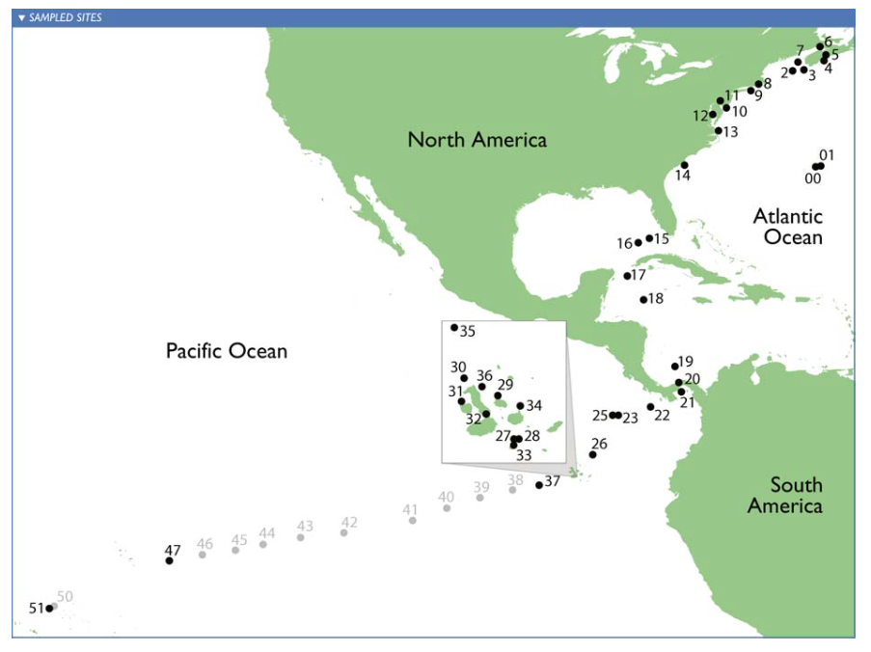
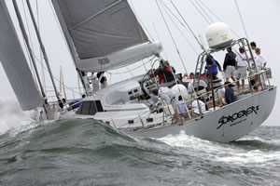
Microbial diversity: Sorcerer II Global Ocean Sampling Expedition
How many different species in a sea water sample? What is their abundance distribution? (alpha-diversity) [Hint: ~10,000 different types of microorganisms]
Are samples from tropical area and temperate area different?(beta-diversity) [Hint: Yes, but how different?]
Notes:
Species diversity is an important measurement of ecological
communities. Scientists believe that there is a strong relationship between species diversity and ecosystem processes. It is not surprisne that environment has influence to the composition of species in a sample. For example, in 2007, scientist sailed a ship called sorecere ii from norht atlanta to caribbean to south pacific and collected the marine samples in different locations. by the way I am so jealously of their samping journey, it is so cool. All the efforts of sampling want to answer questions like this: firstly.. This is alpha diversity. About the richness of species, or evenness of distribution.
The other question to ansser is are the sampels different? If thery are collected from different locations. Such comparison between samples is beta diversity.
So alpha and beta diversity are the two most important aspects of diveriisyt analysis, which will be the target of my project is to find a way to maeasure lpha and beta diversity efficiently and effectively.

Slide 4
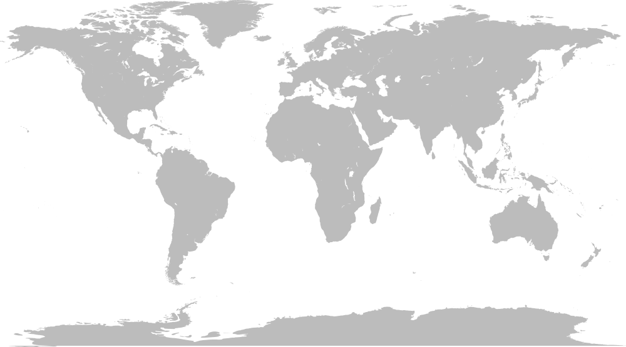
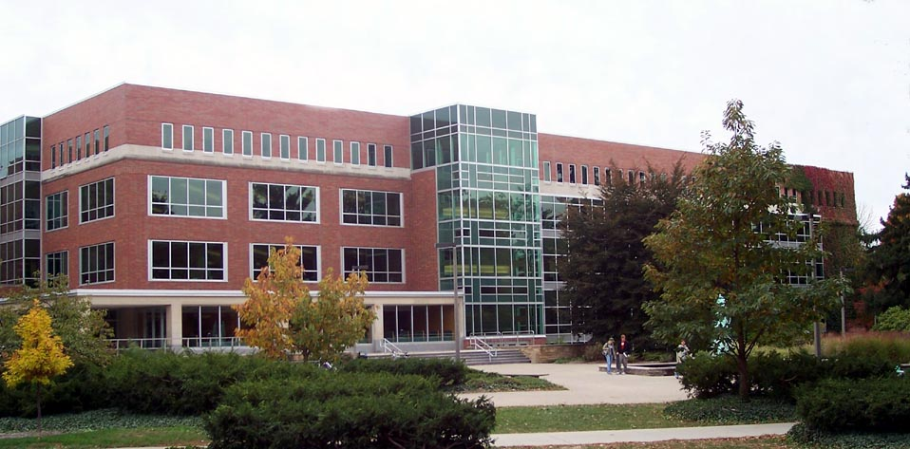

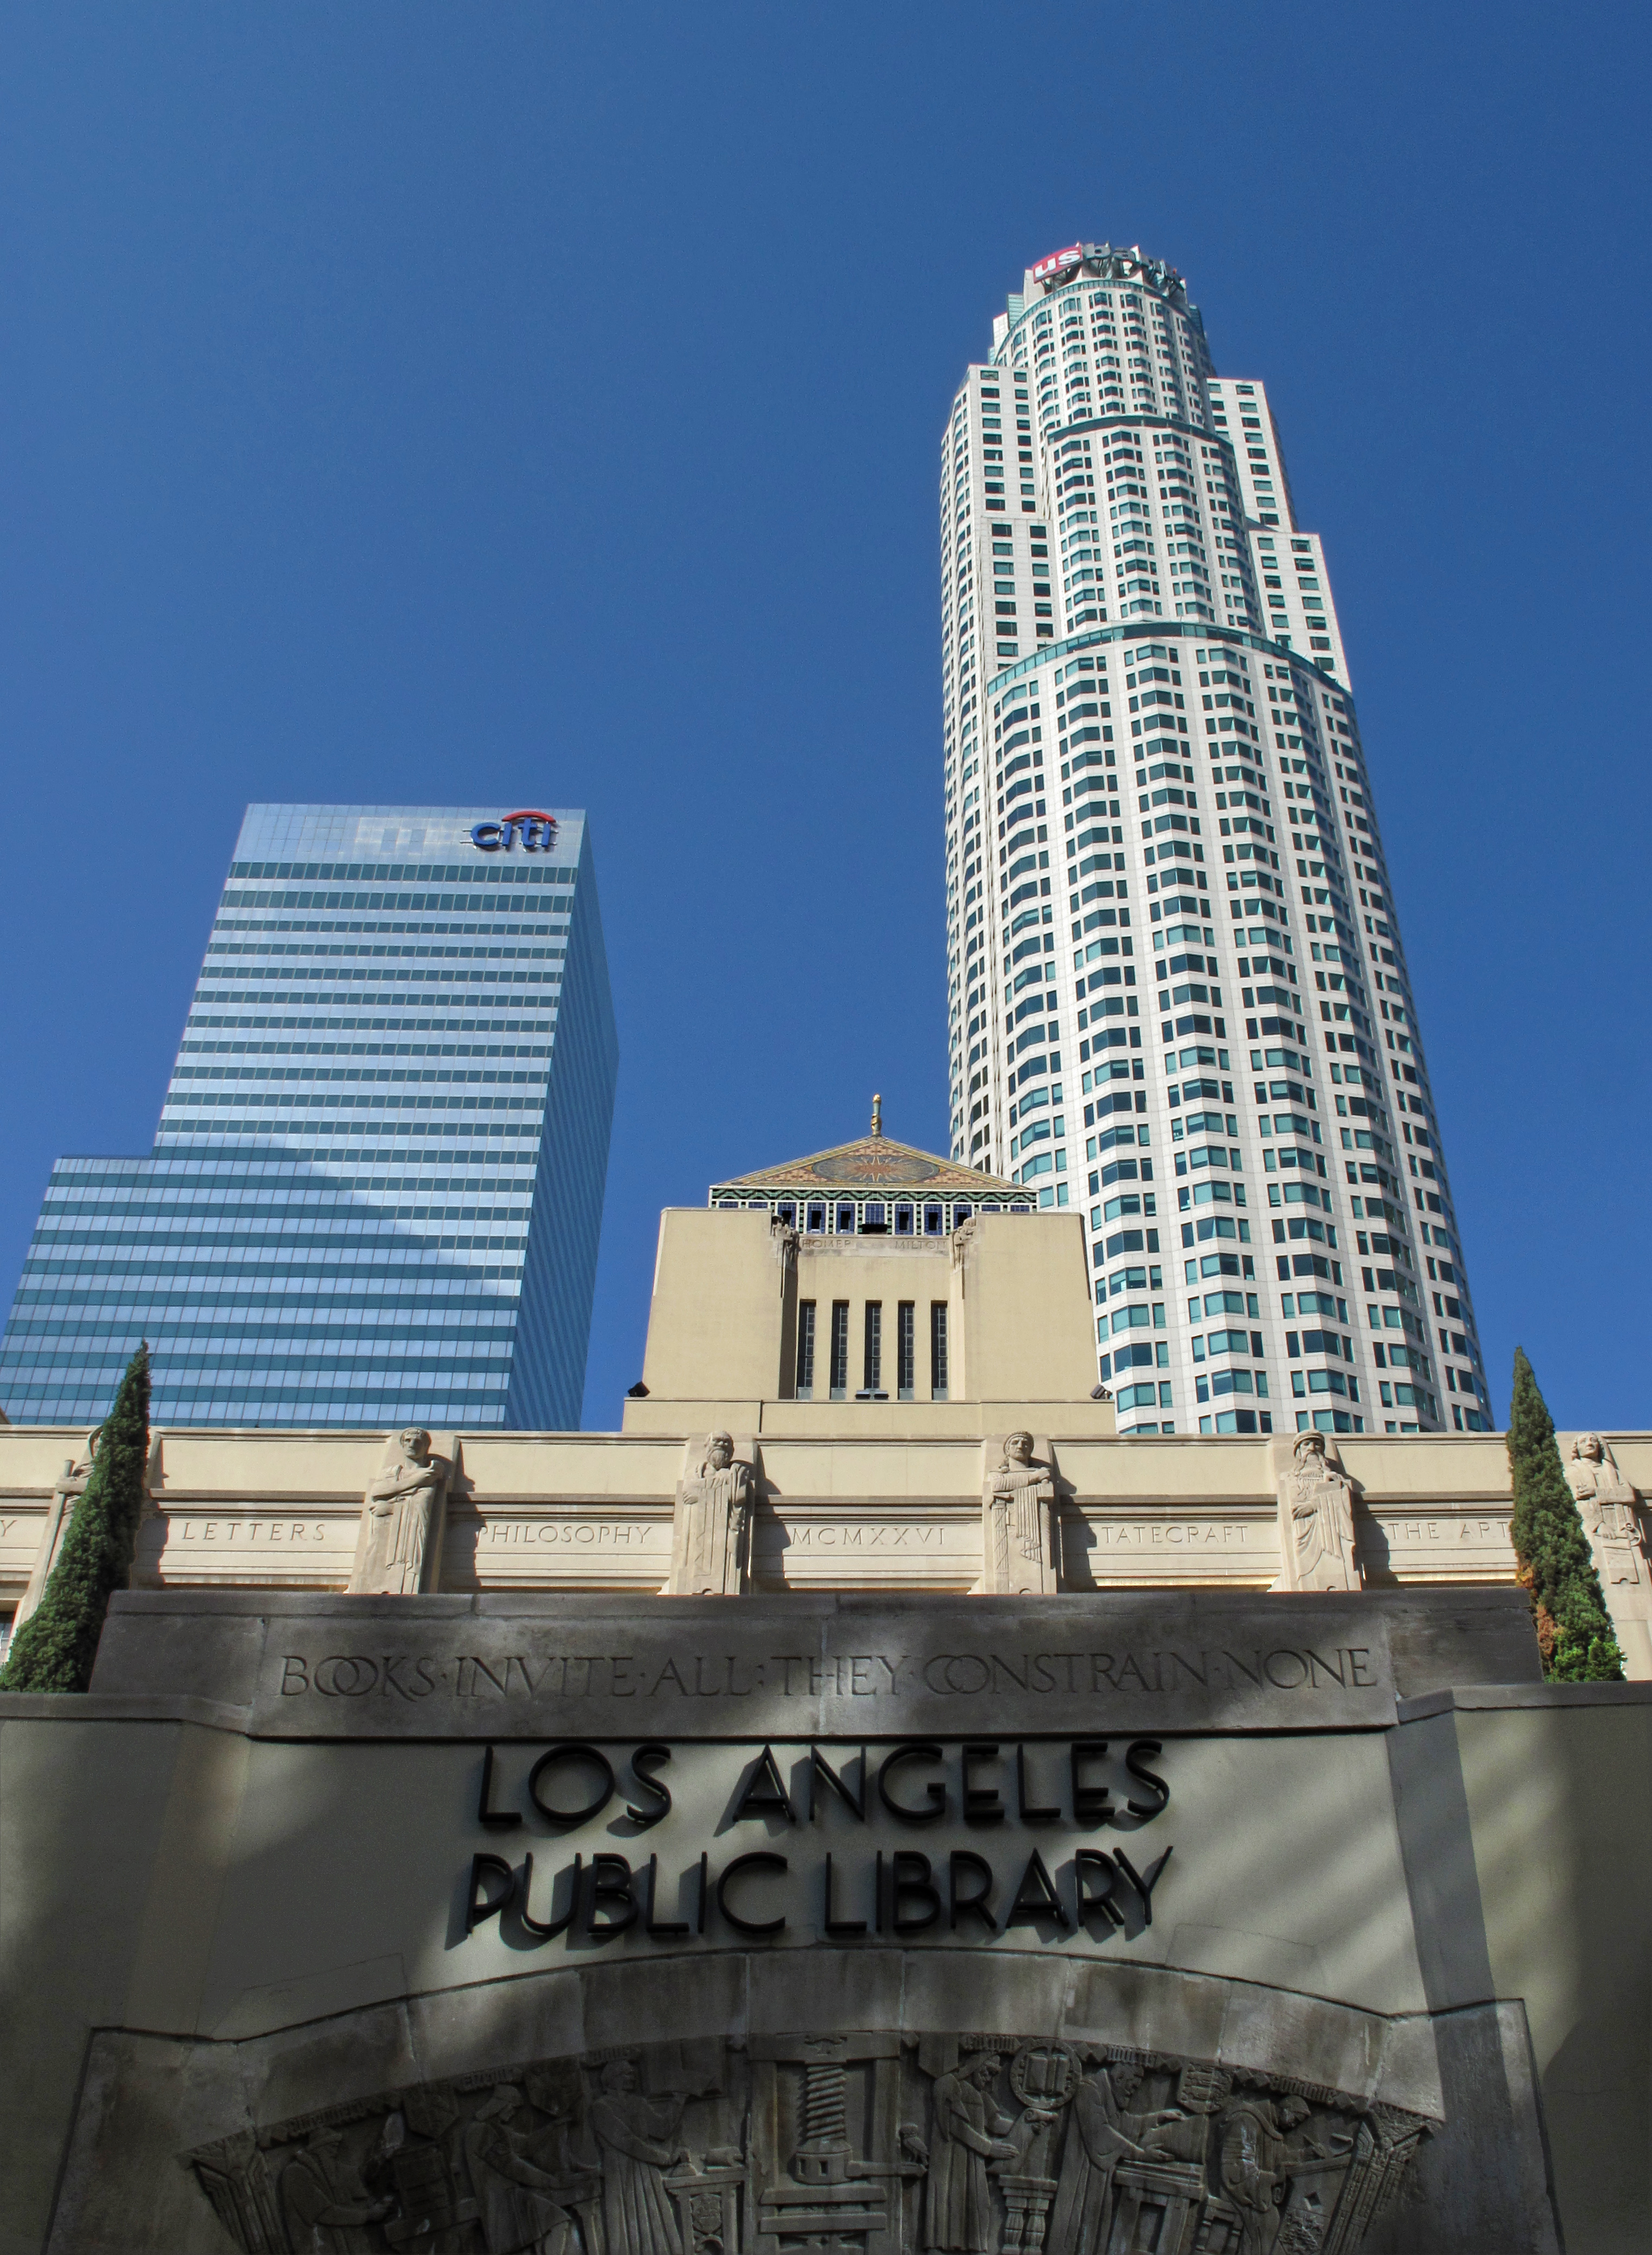
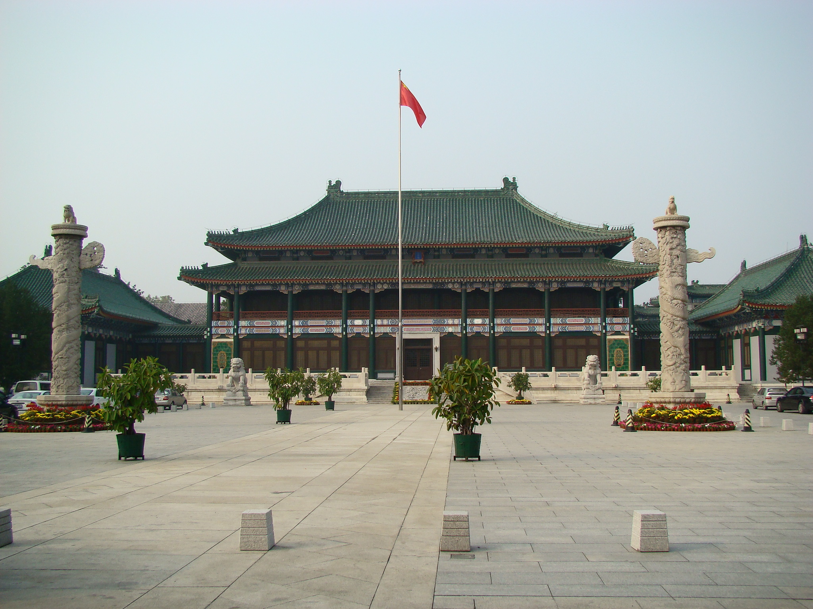
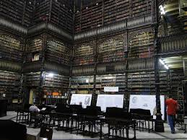
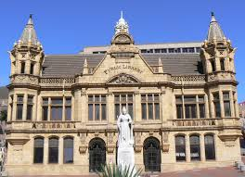

Sample and Library
Notes:
If a genome can be seen as a book. Then the samples with many species can be seen as library. Just like we have samples from different locations. We have library in different locationas around the world.
Analogy to library – books – shredded sentences

Slide 5
Which library has more titles?
Notes:
Now we ask diversity question to the libraries. Which library has more titles? Ok we can check each book. But for metagenomic data set, we can not count bacterials directly, we only have reads, from many species altogether.

Slide 6
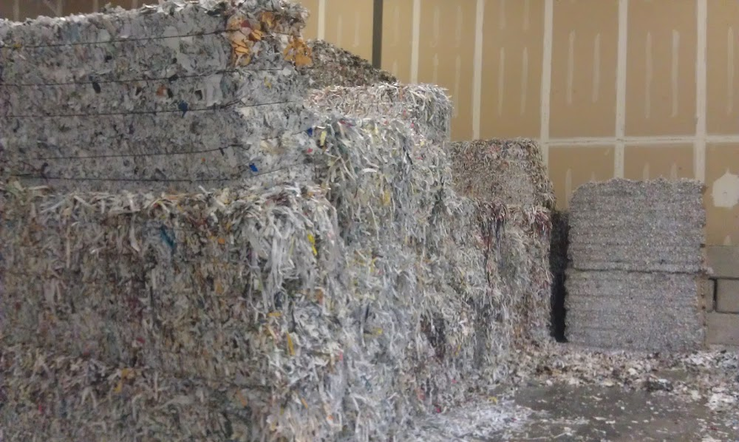
Which library has more titles?
With only shredded pieces of pages with (partial) sentences on it to read.
Notes:
We only have shredded pieces of pages of the books in the libraries. With the stackes of sheredded pages, can we answer the question ?

Slide 7
How similar are the libraries by their collection?
With only shredded pieces of pages with (partial) sentences on it to read.
Notes:
Similarity, beta diversity, how similar are the … by their collection? this looks challenging. Methods have been developed to answer such questions in metagenomics. Let’s have a ccheck

Slide 8
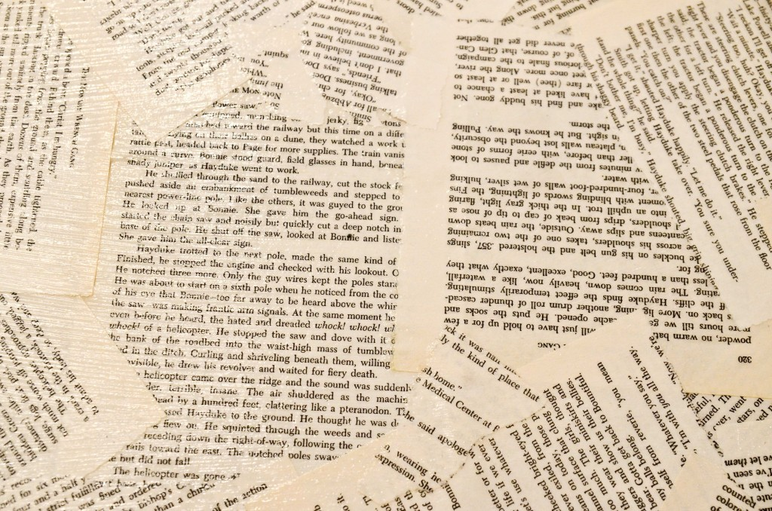

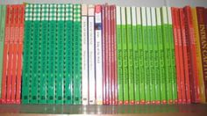
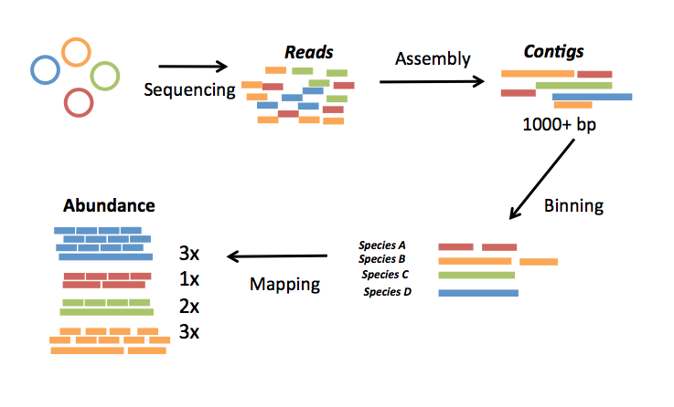
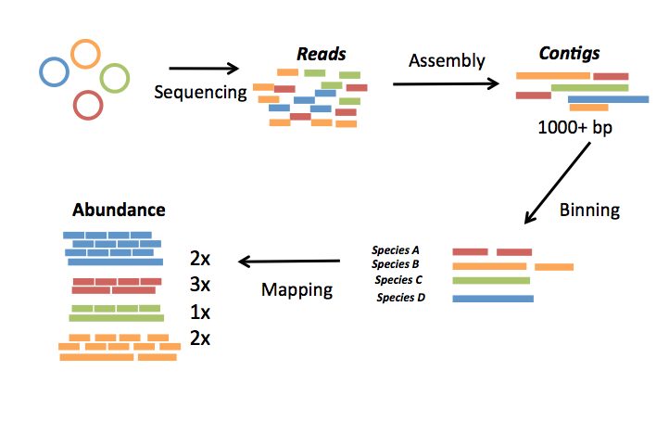
A typical pipeline of metagenome diversity analysis
Sample1
Reads
Assembly
Contigs
Sequencing
1000+ bp
100-150 bp
Abundance
Species
Binning
3x
1x
1x
2x
Species A
Species B
Mapping
Species C
Species D
 | Sample1 | Sample2 | Sample3 | Sample4 | Sample5
Species A | 3 | 3 | 4 | 4 | 0
Species B | 1 | 3 | 0 | 2 | 2
Species C | 1 | 2 | 2 | 2 | 3
Species D | 2 | 1 | 2 | 1 | 1
Sample5
Sample4
Sample3
Sample2
Loosely based on slide by Mads Albertsen
Notes:
So this is a typical pipeline of …..
Firstly we have discussed this, we do the sequencing to all the species algethter without isolating. Just like we got the stack of shreded pages. Then the reads will be assembly into contigs. It is like solve a puzzle, and recover the pages out of the shreaed pages. But we don’t know which books they belong to . Next step is binning, the contigs can be classified and grouped to the species they belong to, just as the pages are grouped into books.
Finally map the reads to the species, to have the abundance of speceis in the sample. Also its like get the copy number of each titlein a library.
For each sample, we can have such species abundance information, so finally we can have a table like this. We call this tabel sample by species table.

Slide 9
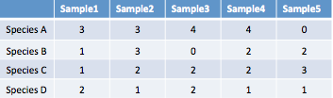
A typical pipeline of metagenome diversity analysis
Sample1
Reads
Assembly
Contigs
Sequencing
1000+ bp
100-150 bp
Abundance
Species
Binning
3x
1x
1x
2x
Species A
Species B
Mapping
Species C
Species D
Samples by species table
Challenges:
Assembly? - difficult (eg. Only small portions of reads can be assembled)
Binning? – difficult (eg. may need reference genomes, computationally expensive)
Mapping? – difficult (eg. accuracy, computationally expensive)
4 petabase pairs of DNA in a gram of soil(Jack A. Gilbert,2013)
Notes:
So the wuqesiton is can we find a shortcut, to do diversity anslyiss, alike get the clustering, without ….
We have been looking for such shortcut for a long time. The first try looks straightforward. Coutning k-mers.

Slide 10
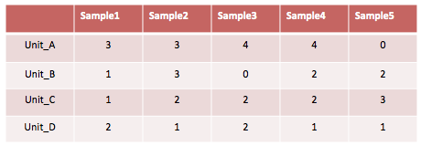
A typical pipeline of metagenome diversity analysis
Sample1
Reads
Assembly
Contigs
Sequencing
1000+ bp
100-150 bp
Abundance
Species
Binning
3x
1x
1x
2x
Species A
Species B
Mapping
Species C
Species D
Species-by-sample table
Notes:
Actually we did find such unit finally.
The first thing we think of is kmers,

Slide 11
3:2:2
3:2:2
2:0:3
2:0:3
2:4:3
3:2:2
3:2:2
2:0:3
2:0:3
2:4:3
3:2:2
3:2:2
 | SampleA | SampleB | SampleC
IGS1 | 3 | 2 | 2
IGS2 | 3 | 2 | 2
IGS3 | 2 | 0 | 3
IGS4 | 2 | 0 | 3
IGS5 | 2 | 4 | 3
2:4:3
3:2:2
3:2:2
2:4:3
3:2:2
3:2:2
2:4:3
2:4:3
3:2:2
3:2:2
2:4:3
2:0:3
2:0:3
3:2:2
3:2:2
2:0:3
2:0:3
2:4:3
2:0:3
2:0:3
2:4:3
Notes:
The same for other samples. The reads in each bin was same coveage profile, they should covera the same genomic region. The same igss.
So thes igs are shared by the samples.
And we can get the abundance of these igss.
So now we have the .. By table.
With this table

Slide 12
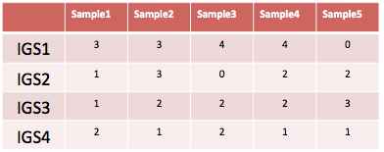
A typical pipeline of metagenome diversity analysis
Sample1
Reads
Assembly
Contigs
Sequencing
1000+ bp
100-150 bp
Abundance
Species
Binning
3x
1x
1x
2x
Species A
Species B
Mapping
Species C
Species D
Species-by-sample table
Challenges:
Assembly? - difficult (eg. Only small portions of reads can be assembled)
Binning? – difficult (eg. may need reference genomes, computationally expensive)
Mapping? – difficult (eg. accuracy, computationally expensive)
4 petabase pairs of DNA in a gram of soil(Jack A. Gilbert,2013)
Notes:
Now we have igs and we find the short cut, and do diversity anslsyis.
We can measure diversity basedon the by tables. Finally.

Slide 13
IGS(informative genomic segment) can represent the novel information of a genome
IGS (informative genomic segment): genomic segments that do not share genomic content with the same length of read
The more IGSs there are in a sample, the higher diversity , higher richness the sample has.
The more IGSs two samples share, the more similar the two samples are.
(meta)Genome size = number of IGSs x IGS length (read length)
Notes:
So what is igs actually then?
Actually they are the ….
Then rpresented , the more .. The more..
Also if we can estimate the number of igs we can also estimate the .. Genome.

Slide 14
Sorcerer II Global Ocean Sampling Expedition
It has been calculated that microbes in ocean account for about half of the biomass on Earth.
In a drop (one millilitre) of seawater, one can find 10 million viruses, one million bacteria
Notes:
Reasl data et, the sea water got sampled in diffenrelnt locations. Got sequenced. Got ther eaed with
Using igs methods.
Longer reads. older sequencing tech. 2007.
This is older, with longer reads, smaller datasets.

Slide 15


Samples can be separated by locations using IGS-based method – as good as the result in original research based on alignment-based method or better.
Tropical and Sargasso
Tropical - Galapogas
Tropical – Open Ocean
Sargasso
Temperate
Temperate - North
Temperate - South
Estuary
Notes:
Clustered by the locations. We can see the temprerate and tropocial are seperated succeffuly.
Actaul yif we check the cluster got by the authours,
One sample si clusteredinto wrong branch, but in our result, ti correct.
The location temperature, afect the compositon of microbial organisms.

Slide 16
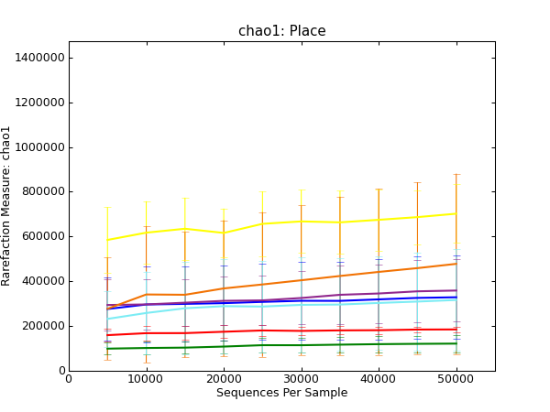
Alpha diversity analysis shows samples from tropical area have higher richness.
Sargasso
Tropical and Sargasso
Tropical - Open Ocean
Tropical - Galapogas
Temperate -South
Estuary
Temperate
Temperate - North
Notes:
Tropical has higher richness. Rlated to the nutrition.
This is not discussed explictly in the original paper. This makes sens.e

Slide 17
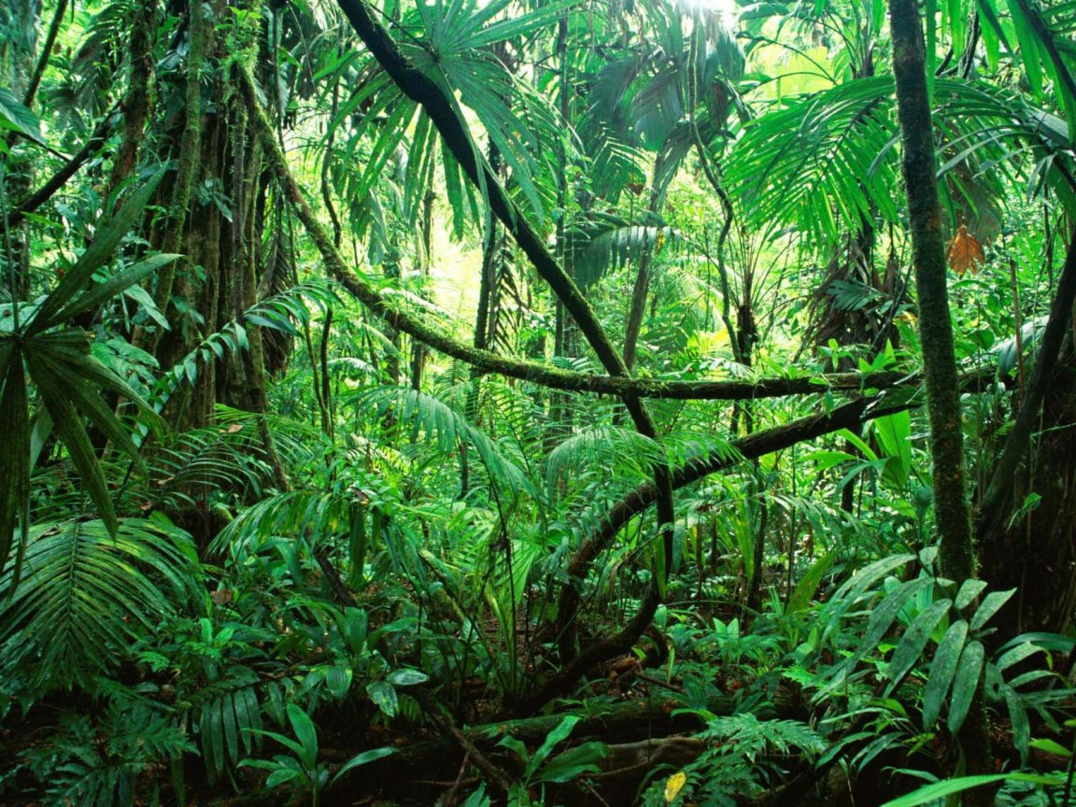
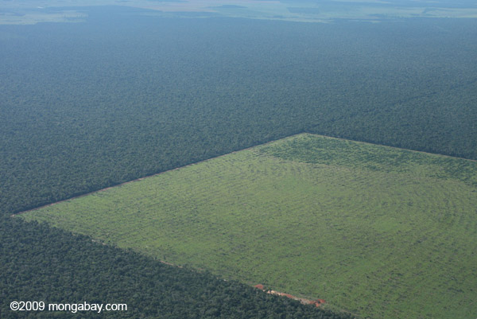
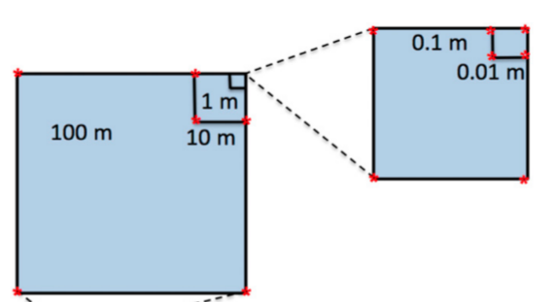
ARMO (Amazon Rain Forest Microbial Observatory) project
Soil metagenome sample | Number of reads | Number of k-mers k=29 | Number of unique k-mers
IOHH.2301.7.1859 | 273,021,397 | 32,762,567,744 | 22,333,571,795
21 samples, 1T size of data, 5 billion reads.
Notes:
The Amazon rainforest is the Earth’s largest reservoir of plant and animal diversity, and it has been subjected to especially high rates of land use change, primarily to cattle pasture.
The goal of this study is to understand the effect of agriculture practice (conversion of forest to pasture) on microbial community.

Slide 18
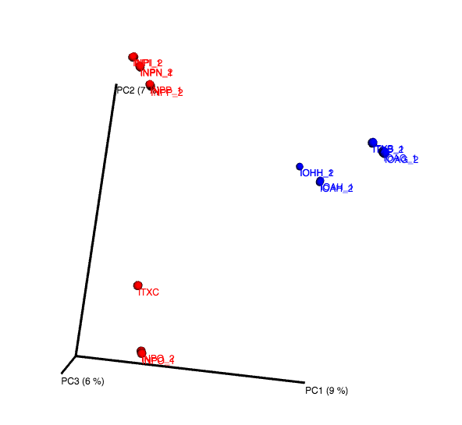
Blue: Prairie
Red: Forest
Conversion (forest -> pasture) affects composition
Prairie samples more similar in space
Subsamples with 8M reads are used.
Notes:
Can be seperated by treatment.
Our results show that bacterial community composition was significantly altered by the forest-to-pasture conversion.
Prairie smaller beta diversity than forest. Cultivation will influence the composition a lot.

Slide 19
Samples can be clustered by different treatments and distances using IGS method.
0.1m
0.01m
10m
100m
Blue: Prairie
Red: Forest
0.1m
0.01m
1m
10m
Notes:
Look at the clustering, distance got from the igs method correlates with the distance between sampling location pretty good.

Slide 20
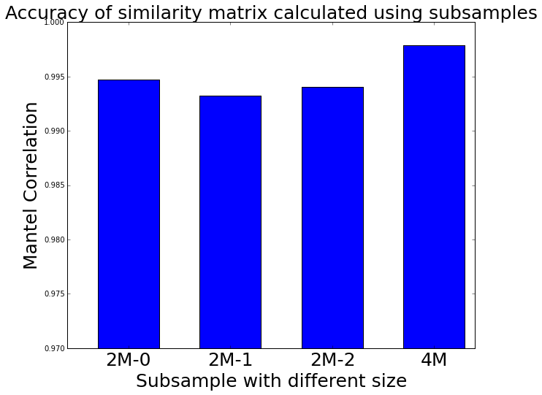
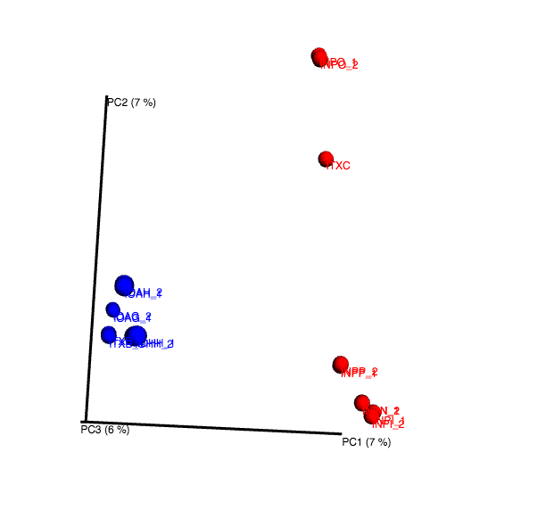
Blue: Prairie
Red: Forest
Mantel correlation to similarity matrix calculated from subsample with 8M reads
Using subsamples can get decent result of beta diversity.
Notes:
Previous analys are perfromed to sabsampels with 8m reads, a small proportion we can see the differene,
We have shown using simulated data, beta more reliable, less prone to ..
Now we use the real ata set to check again.
So we use threee diffeent subsampels with 2m reads, and 4milions
Calculate the

Slide 21
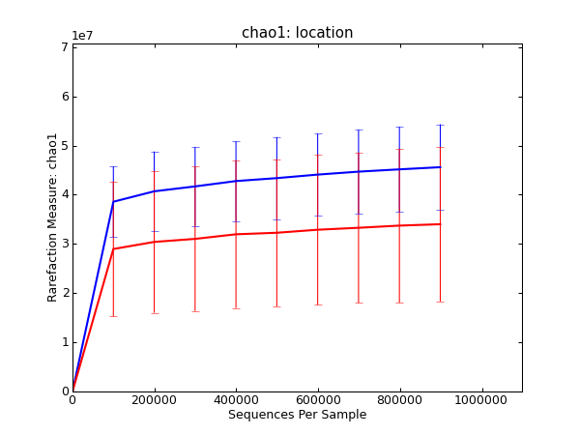
Blue: Prairie
Red: Forest
Alpha diversity analysis shows samples from prairie area have higher richness than forest area.
Notes:
Prairie have higher richness ,diversity ahn forest.
All these results are consistent to the result acquired by the auhoter of the project using traditional method, invlinvg assemlby, annotation.

